Slide 1

INSTITUTE - UIE
DEPARTMENT- ACADEMIC UNITS
Bachelor of Engineering (Computer Science & Engineering)
Subject Name: Elementary Data Structure Using C++
Code:23CSH-103
LINKED LIST
DISCOVER . LEARN . EMPOWER

Slide 2


Elementary Data Structure Using C++
Course Objectives
To enable the students to understand various stages and constructs of C++ programming language.
To improve their ability to analyze and address variety of problems in C++.
To understand the concept of data structures and various operations on them.
To understand the properties of various data structures and able to identify the strengths and weaknesses of different data structures.
To analyze and compare the efficiency of algorithms and learn to design efficient algorithms for solving computing problems

Slide 3



Course Outcomes
CO Number | Course Outcome
CO1 | Understand the concepts of object-oriented programming including programming process and compilation process.
CO2 | Apply different techniques to decompose a problem and programmed a solution with various concepts of object-oriented programming language.
CO3 | Analyse and explain the behaviour of linear data structure operations using the programming addressed in the course.
CO4 | Implement and evaluate the programs using the syntax and semantics of object-oriented programming.
CO5 | Design the solution of real-world problems in order to determine that the program performs as expected.

Slide 4

Scheme of Evaluation

Slide 5
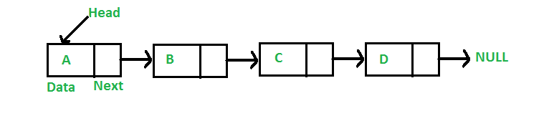
Link List
A linked list is a linear data structure, in which the elements are not stored at contiguous memory locations.
A rundown executed by every thing having a connection to the following thing.
Every hub comprises of its own information and the location of the following hub and structures a chain.
Connected Lists are utilized to make trees and charts.
https://www.geeksforgeeks.org/data-structures/linked-list/

Slide 6
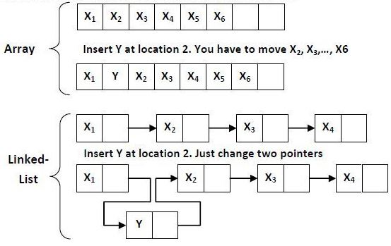
ARRAYS VS LINK LISTS
Arrays and Linked Lists both are direct information structures, yet the two of them have a few points of interest and drawbacks over one another.
A rundown executed by every thing having a connection to the following thing.
Every hub comprises of its own information and the location of the following hub and structures a chain.
Connected Lists are utilized to make trees and charts.
https://www.google.com/search?biw=1600&bih=789&tbm=isch&sa=1&ei=Ujn6XJKvFPLXz7sP6fCQgAk&q=ARRAYS+VS+LINKLISTS&oq=ARRAYS+VS+LINKLISTS&gs_l=img.12...264094.264094..266665...0.0..0.148.148.0j1......0....2j1..gws-wiz-img.A9FVRjK-qiY#imgrc=t1853XlC8zYF9M:

Slide 7
INSERTING AT BEGINNING OF THE LIST
Lets START is the pointer having the initial position in linked list.
Let data be the element to be inserted in the new node.
POS is the mark where the new node is to be inserted.
TEMP is a temporary pointer to hold the node address.
1. Input data
2. Develop a New Node
3. New Node → DATA = data
4. New Node → Next = NULL
5. If (START equal to NULL)
then START = New Node.

Slide 8
INSERT A NODE AT THE END
Begin
1. Input DATA
2. develop a New Node
3. New Node → DATA = DATA
4. New Node → Next = NULL
5. If (START equal to NULL)
(a) START = New Node
6. Else
(a) TEMP = START
(b) While (TEMP → Next not equal to NULL)
(i) TEMP = TEMP → Next
7. TEMP → Next = New Node
Exit

Slide 9
DELETION
In order to delete FIRST node from linked list we have to consider three possibilities:
(1) List is Empty (START = NULL). In this case we can not delete node from linked list.
(2) There is only one node in the linked list
(START->LINK=NULL). In this case we can delete the first node and then linked list becomes empty (START=NULL).
(3) There are more then one nodes in the linked list. In this case we can delete the first node.
After deleting the first node we have to move FIRST pointer to next node so that it can points to the newly first node in the linked list.

Slide 10
DELETION
In order to delete FIRST node from linked list we have to consider three possibilities:
(1) List is Empty (START = NULL). In this case we can not delete node from linked list.
(2) There is only one node in the linked list
(START->LINK=NULL). In this case we can delete the first node and then linked list becomes empty (START=NULL).
(3) There are more then one nodes in the linked list. In this case we can delete the first node.
After deleting the first node we have to move FIRST pointer to next node so that it can points to the newly first node in the linked list.

Slide 11
FAQ
What is the complexity of search operation in linked list?
How linked list is better than array?
In what cases link lists give worst results?

Slide 12
APPLICATION OF LINK LIST
Pre-characterized number of classifications suggests that we can utilize a basic static structure like cluster to speak to the classes. Since we don't have the foggiest idea about the quantity of things in every class, we can speak to things in every classification utilizing a connected rundown. So what we need is a variety of connected records
You can likewise consider speaking to a web list utilizing a variety of connected records, where exhibit contains the catchphrases and connected records contains the web URL's the place that watchword happens.

Slide 13
REFERENCES
https://www.cs.cmu.edu/~adamchik/15-121/lectures/Linked%20Lists/linked%20lists.html
https://www.geeksforgeeks.org/data-structures/linked-list/
https://www.tutorialspoint.com/data_structures_algorithms/linked_list_algorithms.htm
https://www.geeksforgeeks.org/merge-two-sorted-lists-place/
https://www.geeksforgeeks.org/reverse-a-linked-list/

Slide 14
THANK YOU

